Slide 1



Slide 2



Slide 3

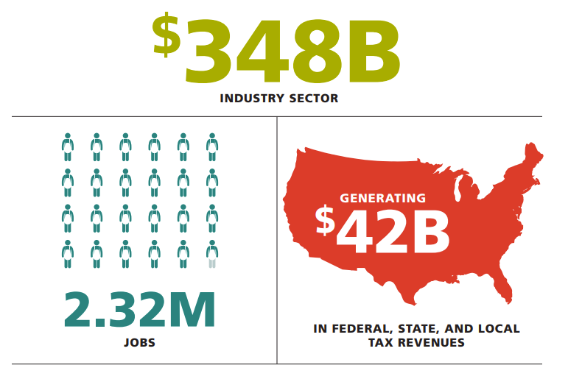
The Horticulture Industry is Big Business!

Slide 4
We Help Our Members
Perform Better | GROW FASTER | PREPARE FOR THE FUTURE
By Highlighting Best Practices | By providing the information needed to drive our industry forward. | Ensuring our industry’s continued growth and success for generations to come.
Through Education | With Trade Shows and Conferences | Through Advocacy
Through Research | With Affinity Programs | Through Plant PAC Initiatives
Through Certification | With Industry Insider Reports | Through Workforce Development
Through Industry Benchmarking & Reporting

Slide 5
Member Benefits
When your company joins AmericanHort at any level, everyone in your organization has access to membership benefits.
Basic Membership
Planting the Seed
Plus Membership
Taking Root
Premium Membership
Flourishing
In addition to Basic & Plus member benefits, Premium members receive:
Quarterly Advocacy Brief Webinars
Access to Renowned Legal & Consulting Services
Industry Benchmark Program
Membership List Rental – set up fee waived
Priority access to Cultivate Housing
In addition to Basic member benefits, Plus members receive:
Discounts on exhibit space at all events
Membership list rental
(additional cost)
Connect, six issues per year
Impact Washington, bi-weekly
24/7 Knowledge Center access
HR Peer Sharing Group
Event registration discounts
Listing in Resource Directory
Business Savings Programs
Notes:
There's simply no better way to grow and thrive, both personally and professionally, than with a Premium Membership to AmericanHort.
Not only is Premium Membership our best value and the level that offers the most for your money, it also ensures that as soon as we learn something important or offer a new benefit or service, you'll have priority access. Your Premium Membership provides you with the collaboration, advocacy, connectivity, research findings, knowledge and leadership we're known for, as well as the high-level consulting services and webinars you need to remove obstacles and achieve your greatest goals.

Slide 6
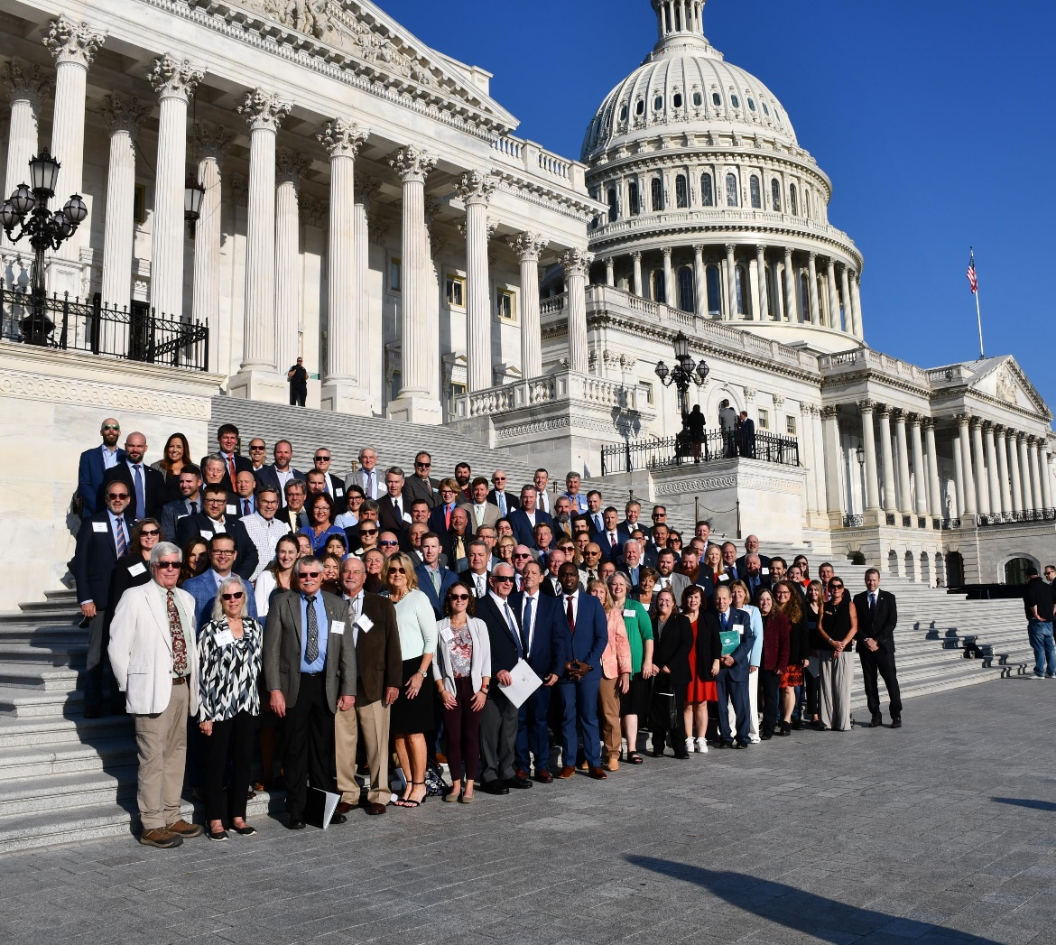
Amplify Your Voice
The ever-changing legislative and regulatory landscape impacts every business. But it is tough to constantly call your elected official when other work priorities demand attention.
As an AmericanHort member, your business interests are represented in Washington, D.C. AmericanHort amplifies your voice by meeting with legislators to educate them on labor, immigration, plant health, production, transportation, research funding, and other concerns.

Slide 7














Optimize Performance & Connect with the Industry
Provide your team with practical green industry training to enhance skills and foster growth.
web series

Slide 8
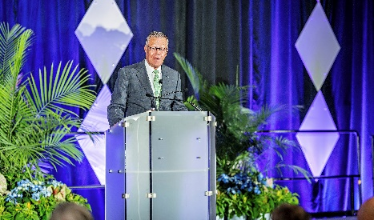
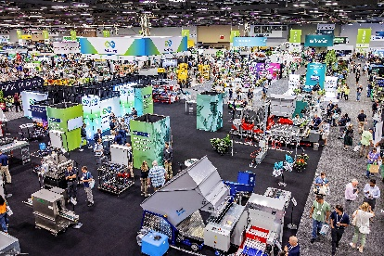



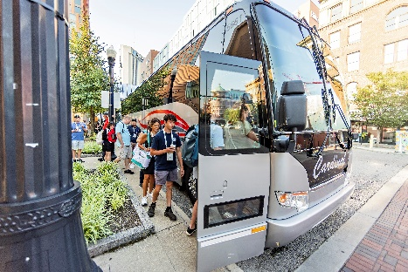
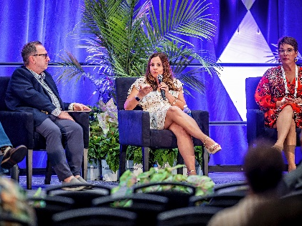

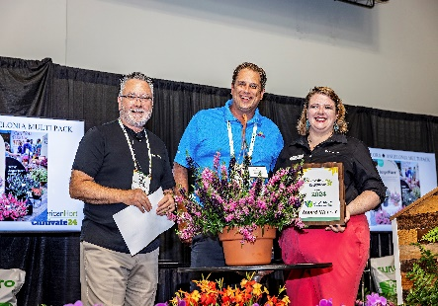

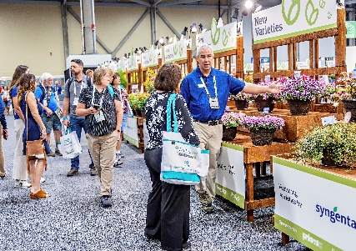
Every July in Columbus, OH
More than +650 Exhibitors
Industry Production Tours
See New Plant Varieties
Explore New Product Innovation
More than +150 education sessions
Connect with the right people!

Slide 9

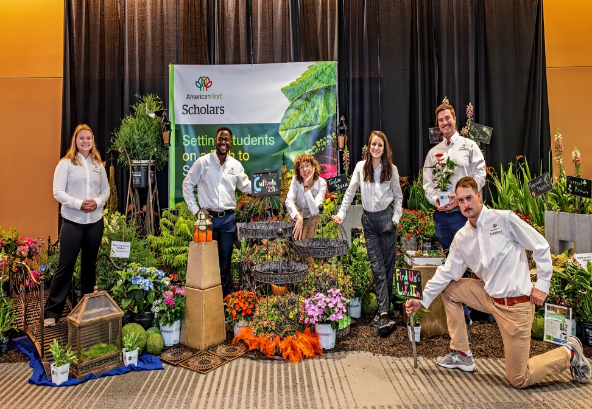
HortScholars Program
Sets Students in Horticulture on a Path to Success
Six Scholars are chosen every year
Selected from 2-year, 4-year and graduate programs
Beyond the Classroom Experience by attending Cultivate
Selected by AmericanHort’s GenNext Community
2024 HortScholars

Slide 10
HRI proudly supports scientific research and students for the advancement of the horticultural industry.
HRI was established by industry leaders on the premise that no one could better direct needed research to advance horticulture than the very people who work in it, day in and day out.
HRI funds horticultural research focusing on the propagation, production, distribution, marketing, and sale of horticultural crops.
HRI has a $20 million endowment and has dispersed more than
$10 million in research support since inception.
7 Scholarship funds to help support horticulture students.
Notes:
Core Purpose of HRI is to
-Focus on Survival Issues
To focus on industry survival issues such as pest management, environmental stewardship and sustainability, marketing, and mechanization/automation to reduce industry vulnerability to labor challenges and to improve production efficiency.
-Encourage Technology Access
To educate and enhance the industry by effectively communicating the results and facilitating the technology transfer of horticultural research.
-Disseminate Information
To act as a clearinghouse for industry research and statistics.
-Build for the Future
To continue to develop Horticultural Research Institution's endowment fund.

Slide 11



The HRI Leadership Academy is a one-year program consisting of in-person training sessions, virtual online classes and meetings, and a capstone project and presentation.
Launched in 2023
Applications accepted November – Early February for the next year’s class
Class members are announced at Cultivate
Learn more at HRILeadershipAcademy.org

Slide 12
Thank you for being a member!
We look forward to working with you.

